Slide 1
A/B Test Analysis for Advertising Campaigns
Goal: Increase the number of "sign_up" and "purchase" events.

Slide 2
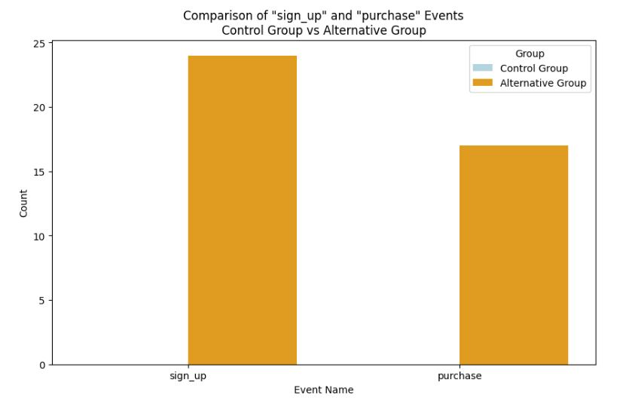
Sign-Up and Purchase Events (Goal of Experiment):
Analysis:
"sign_up" Events: The control group has no occurrences of the "sign_up" event, while the alternative group shows some counts. This indicates that the alternative setup have led to an increase in sign-up events.
"purchase" Events: Similarly, the control group has no occurrences of the "purchase" event, while the alternative group does.
Analysis suggests that the alternative group performed better in terms of the desired events (sign_up and purchase).

Slide 3
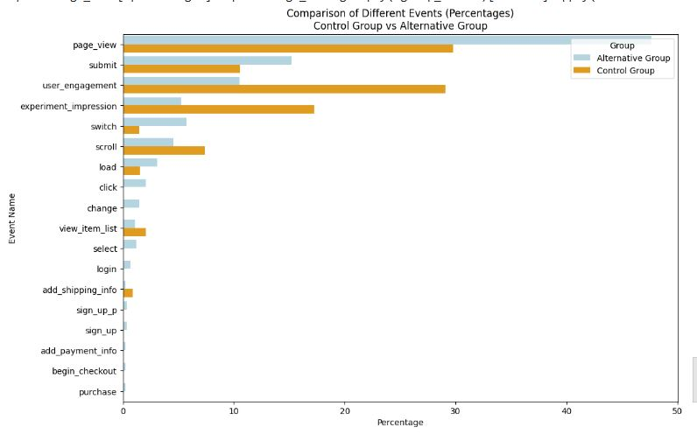
Distribution of events for the control and alternative groups:

Slide 4
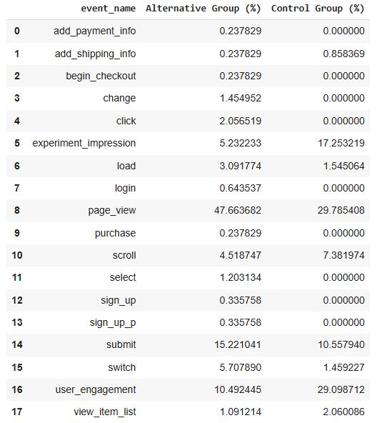
Table with the percentages
Event Name: Describes the specific event.
Control Group (%): The percentage of occurrences of each event within the control group.
Alternative Group (%): The percentage of occurrences of each event within the alternative group.

Slide 5
Page View Event:
Control Group: 29.79% Alternative Group: 47.66%
Analysis: The alternative group has a higher percentage of page views, indicating increased user engagement.
User Engagement Event:
Control Group: 29.10% Alternative Group: 10.49%
Analysis: Despite having fewer page views, the control group has a higher percentage of user engagement events, suggesting amount of time more spent on web page.
Sign-Up and Purchase Events (Goal of Experiment):
Control Group: 0% for both "sign_up" and "purchase."
Alternative Group: "sign_up" is 0.34% and "purchase" is 0.24%.
Analysis: The alternative group shows occurrences of both "sign_up" and "purchase" events, aligning with the goal of the experiment. The control group shows no occurrences of these events.
Overall Interpretation:
The Alternative Group appears to align with the goals of the experiment, showing occurrences of both "sign_up" and "purchase" events. The increase in page views also suggests higher user interest or engagement.

Slide 6
Conclusion
The analysis showed the effectiveness of the Alternative Group in achieving the desired events.
users in the control group are spending more time on the website, reflecting positive engagement. However, this engagement is not translating into the desired actions like signing up or making a purchase.
analysis reveals superior engagement within the alternative group, reflected in higher interaction rates with essential elements of the website. This improved interaction is indicative of a more resonant user experience, highlighting the effectiveness of the alternative approach in connecting with audience.

